Slide 1
MOOC CHALLENGE
SQL
By Nayab Shahzad

Slide 2
Bookworm’s Haven: Online Bookstore Inventory
Task
•You’ve been hired by Bookworm’s Haven to assist with their inventory management! Your quest is to design and implement a database system using SQL to help them keep track of their books, customers and order. Bookworm’s Haven has provided you with the following requirements:
Book Inventory Management: Store information about the books. We need to store each book's title, author, genre, publication year and price.
Customer Management: Store customer details. For each customer, we need to store their full name, email address and phone number. Bookworm’s Haven also allows customers to sign up for their membership and become a Chapter Chaser allowing them to collect points with every purchase. We need to know if the customer is a Chapter Chaser or not.
Order Management: Store information about each order including which customer placed it, the books ordered and the total amount paid.

Slide 3
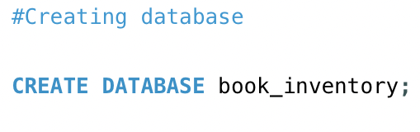
Creating Database
CREATE DATABASE: This is a Data Definition Language (DDL) command used to create a new database in a database management system (DBMS). It tells the DBMS to set up a new database with the specified name.
book_inventory: This is the name of the database you're creating. You can choose any valid name for your database. In this case, the name is "book_inventory".
CREATE DATABASE book_inventory; instructs the DBMS to create a new database with the name "book_inventory". This new database will serve as a container for storing tables, data, and other objects related to your application's book inventory management.

Slide 4
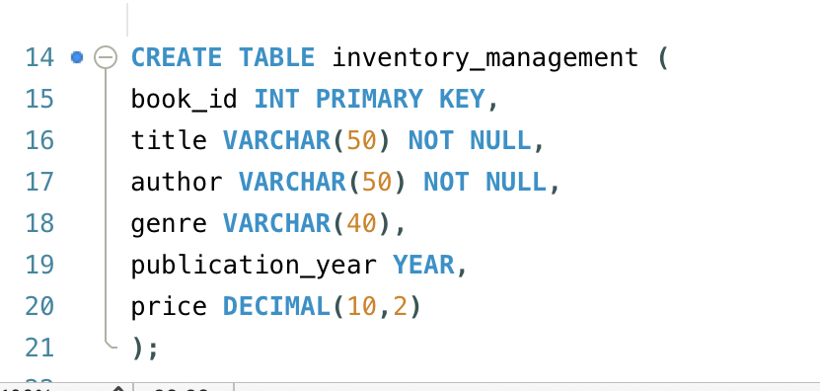
Task 1: Creating the Book Inventory Table (DDL)
DDL (CREATE TABLE) is used to define the structure of the inventory_management table.
book_id is assigned as the primary key using PRIMARY KEY, ensuring uniqueness for each book.
Columns such as title, author, genre, publication_year, and price are defined to store specific book details.

Slide 5
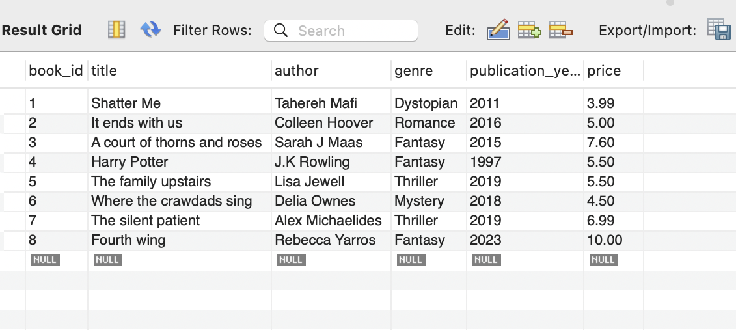
Results for task 1

Slide 6
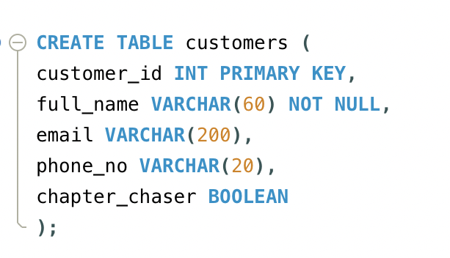
Task 2: Storing Customer Information (DDL)
DDL (CREATE TABLE) is used to define the structure of the customers table.
customer_id is assigned as the primary key for each customer, ensuring uniqueness.
Columns such as full_name, email, phone_no, and chapter_chaser are defined to store customer details.
The chapter_chaser column is a boolean indicating whether the customer is a Chapter Chaser.

Slide 7
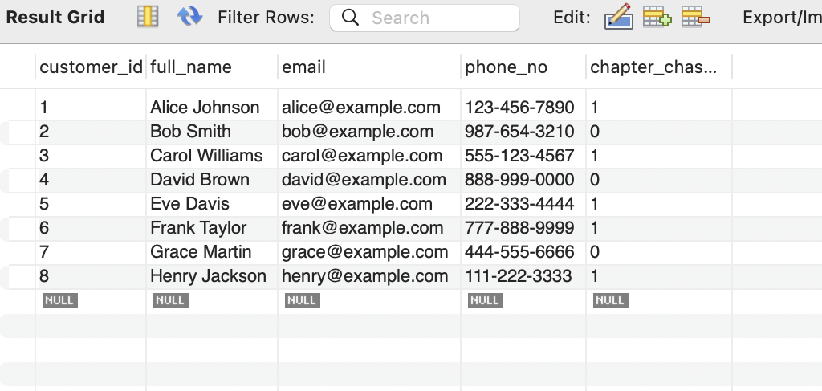
Result for task 2

Slide 8
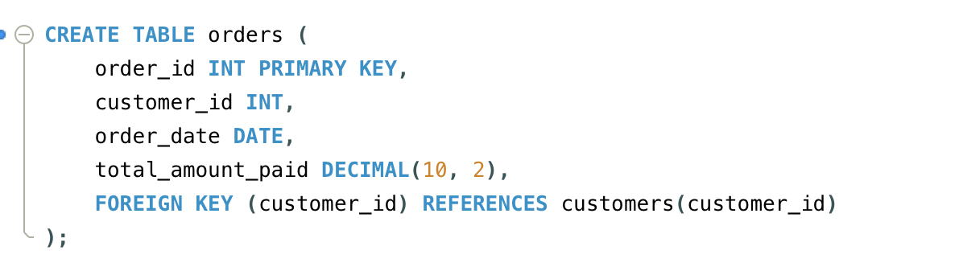
Task 3: Creating the Order Table (DDL, Foreign Key)
DDL (CREATE TABLE) is used to define the structure of the orders table.
order_id is assigned as the primary key for each order, ensuring uniqueness.
A foreign key relationship is established between the customer_id column in the orders table and the customer_id column in the customers table using FOREIGN KEY.
Columns like order_date and total_amount_paid are defined to store order details.

Slide 9
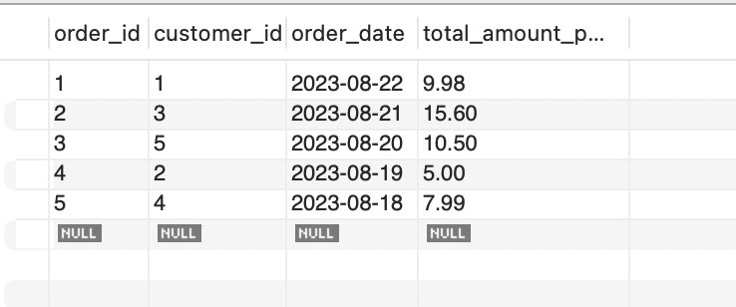
Result for task 3

Slide 10
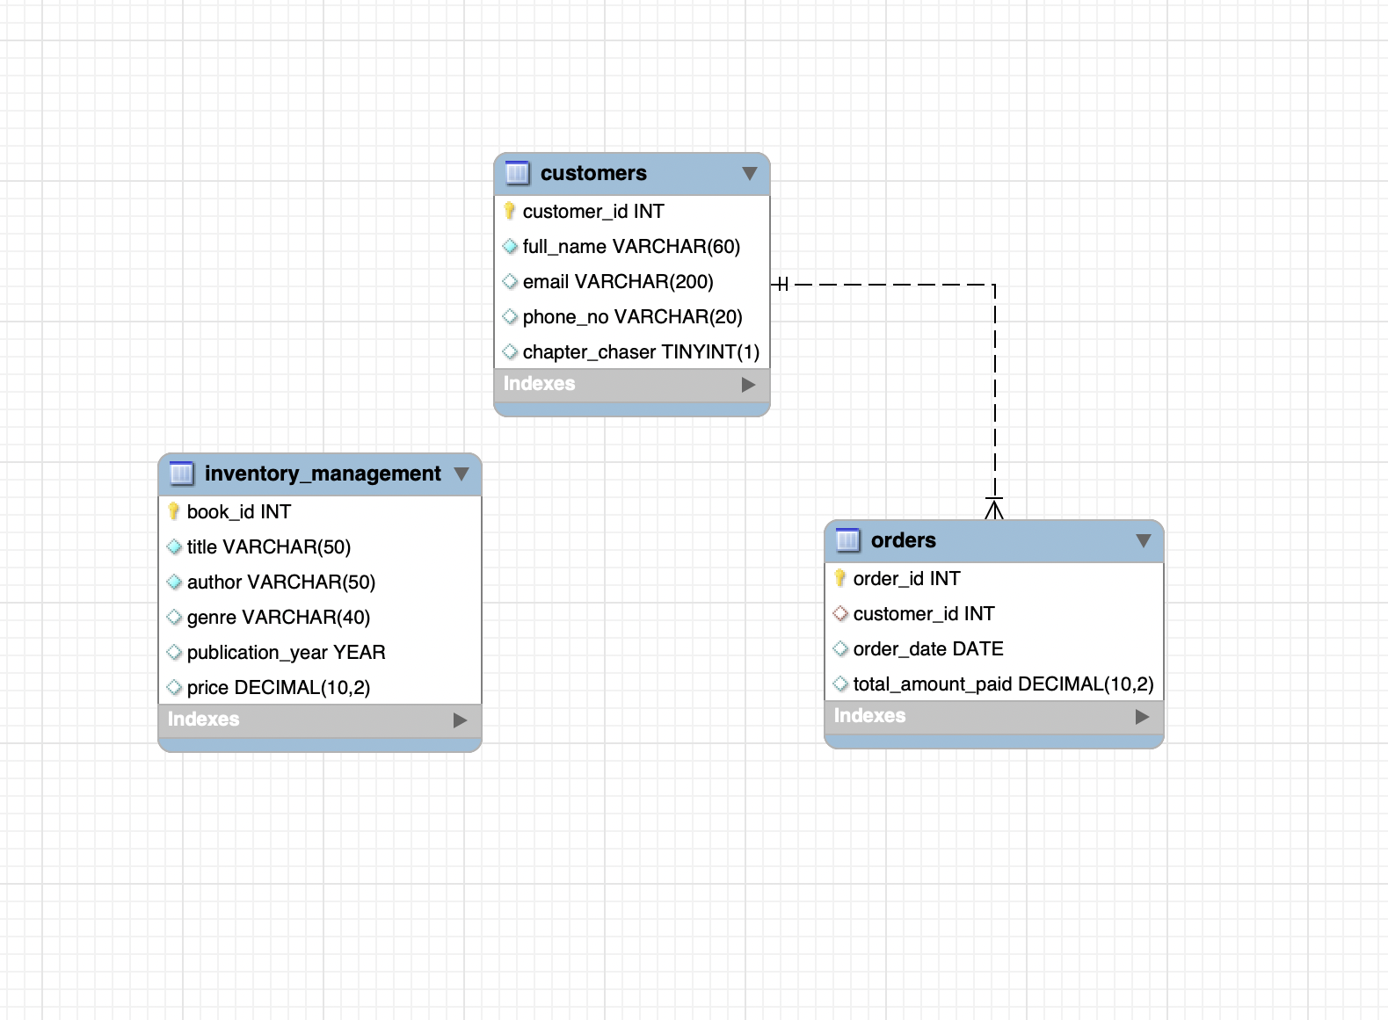
EER Diagram
Relationships:
Inventory management has no direct relationships with other entities
The Customers entity has no direct relationships with other entities
The Orders entity has a relationship with the Customers entity:
One customer can place many orders (One-to-Many relationship).

